Slide 2
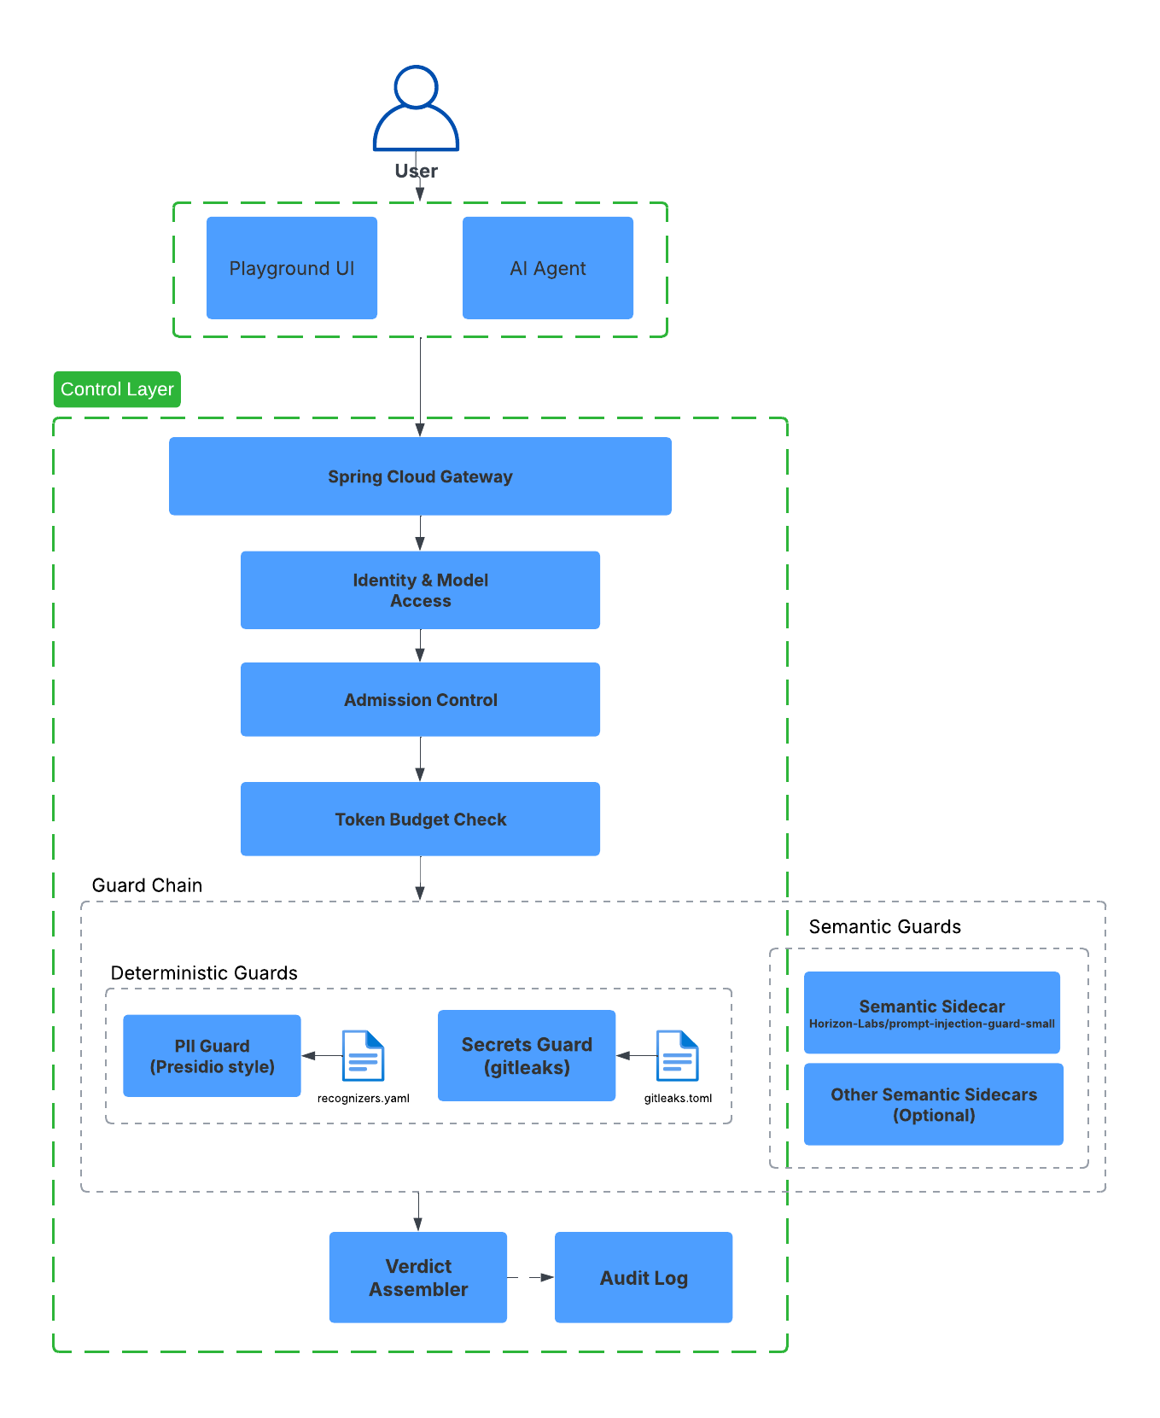
Architecture

Slide 3
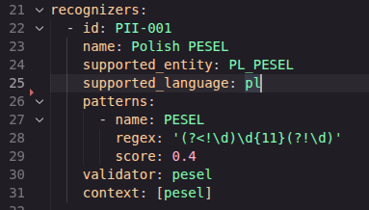
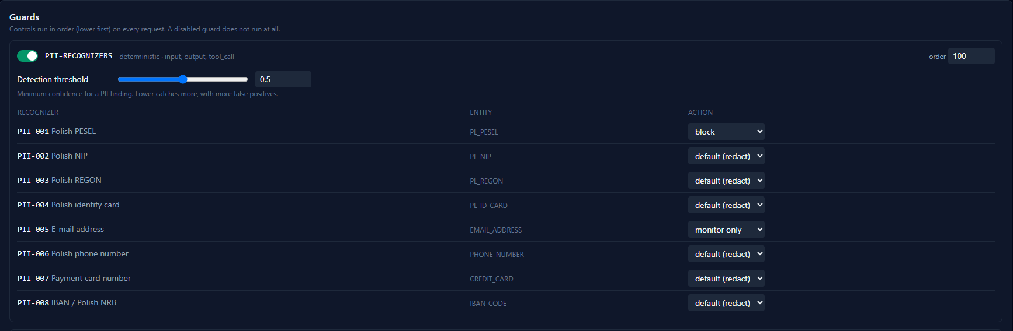
Deterministic guards – PII and secrets
Flexible validators, rules as data
Hot reload - no rebuild needed
Battle-tested rule packs, our engine - 222 Gitleaks rules
+ 8 Presidio recognizers
Execution time <1ms

Slide 4
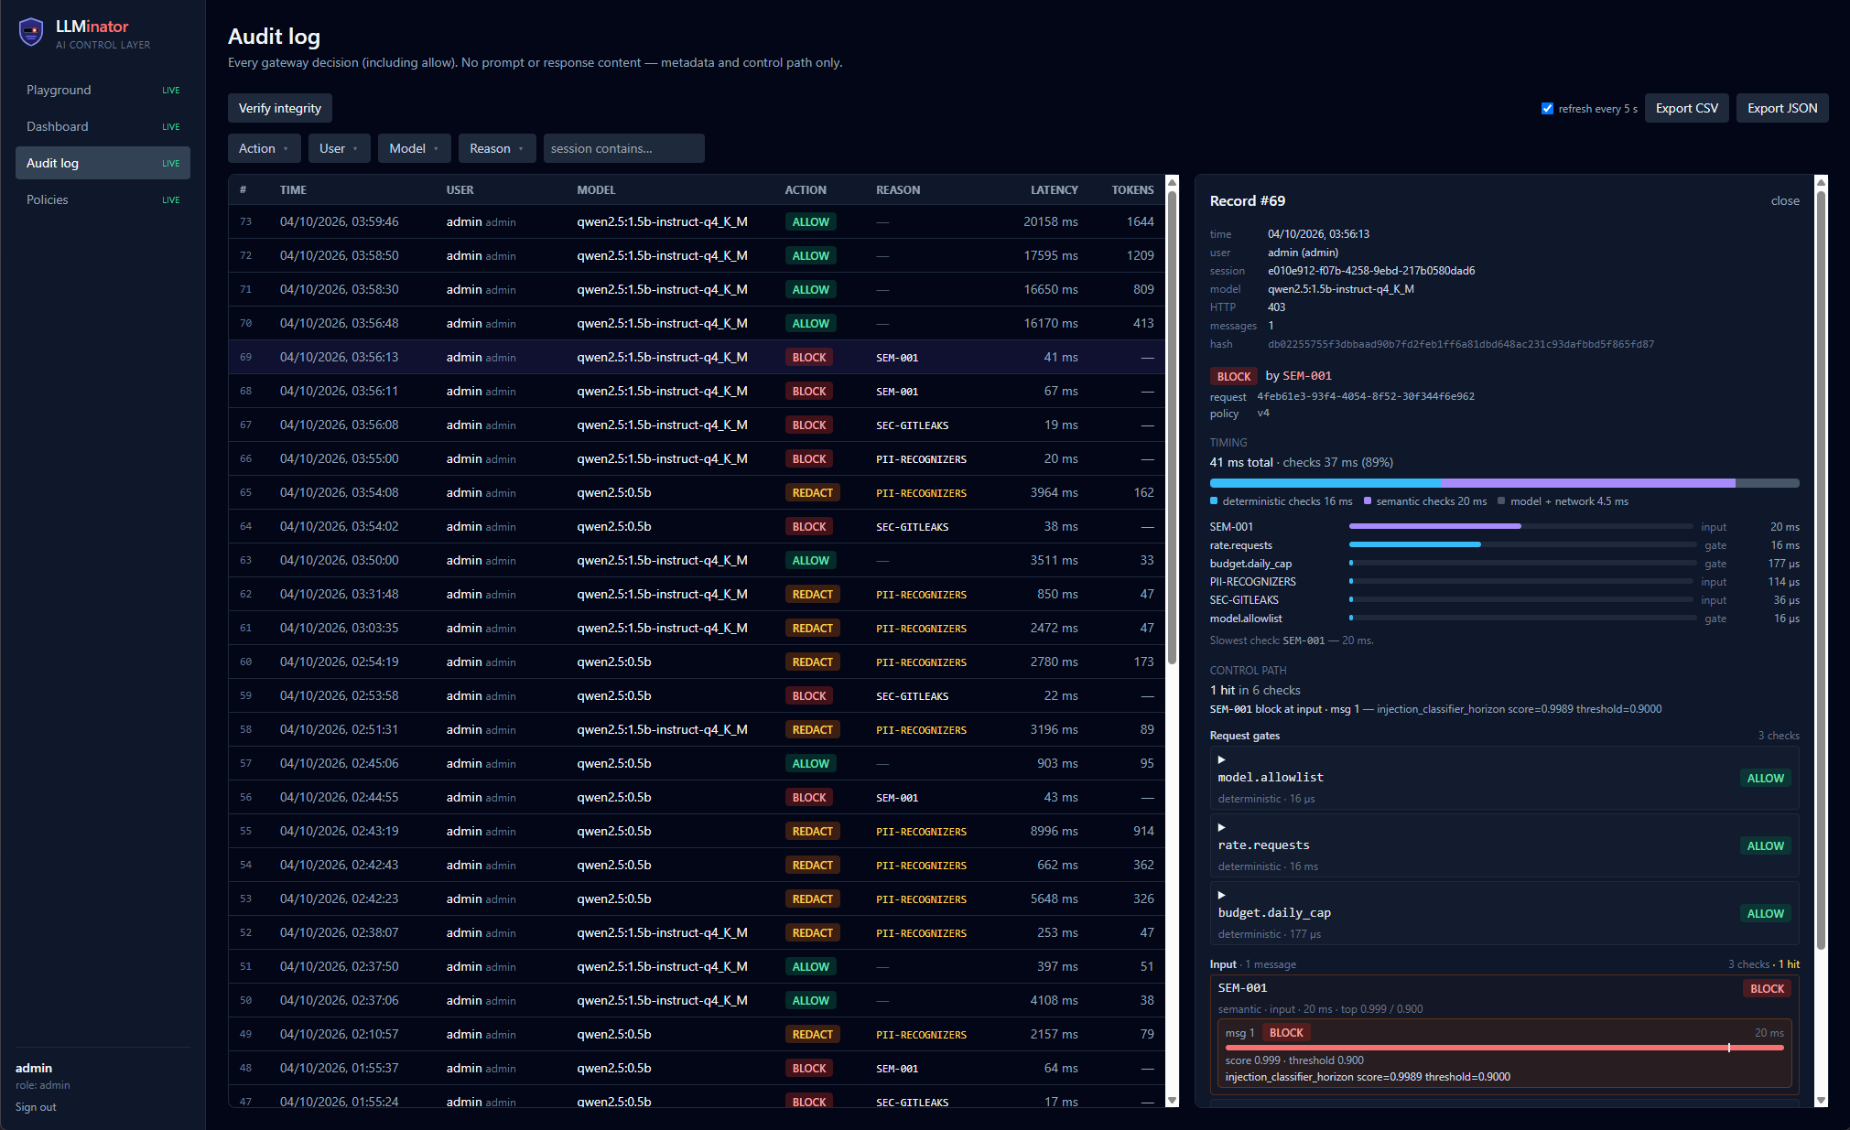
Audit Log
Detailed info about each request
X-Ray for filter chain visualization
Timing details, filter vs model

Slide 5
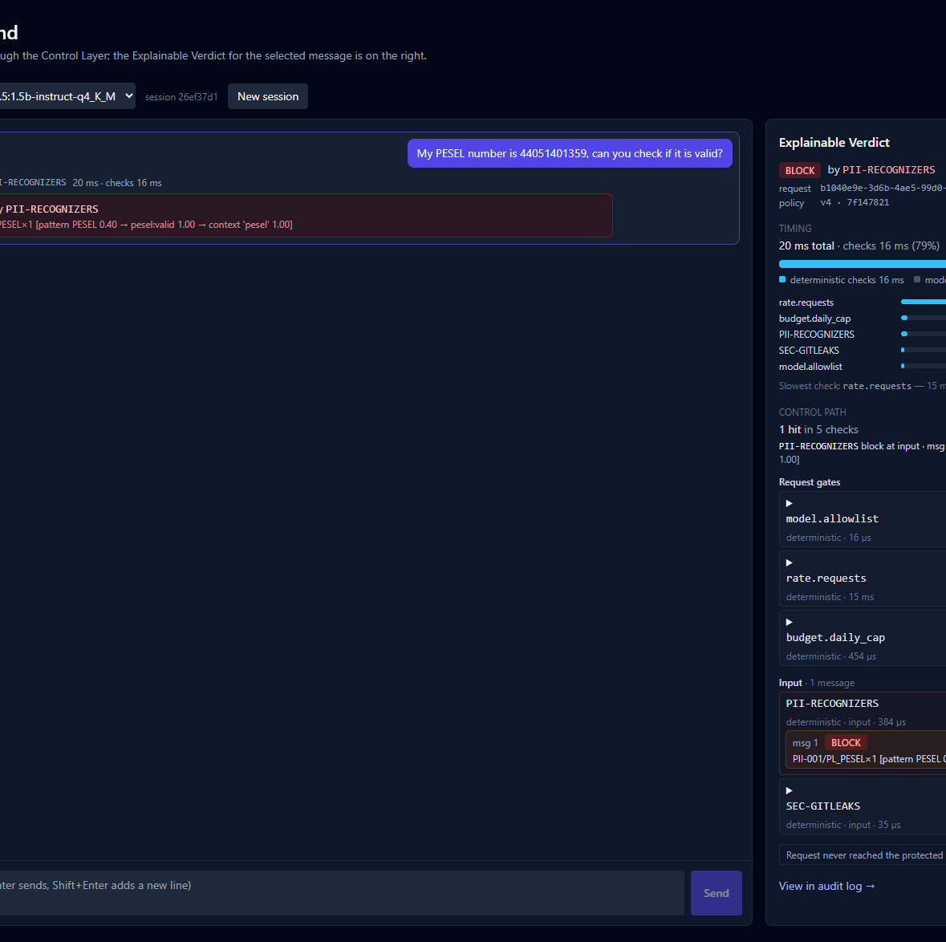
Playground
Playground UI for prompt analysis
X-Ray for filtering
Performance details
Built-in prompt templates for different violations

